Slide 1
Training culturally diverse you
Adapted by Robert Cox from a workshop facilitated by Mick Vande Berg at Purdue University, February 2015

Slide 2
Training culturally diverse you
Get out a clean piece of paper…
Make a circle in the middle.
This represents you…
“ME”

Slide 3
Training culturally diverse you
Make 4-5 circles outside
These represent the “groups” that developed you…can be individuals.
Label each group.
Mother’s Family
Sports team
“ME”
USA
Small Town USA
Father’s Family

Slide 4
Training culturally diverse you
List of attributes
Write down 1-2 things that are the most important to the group.
Mother’s Family
Sports team
“ME”
USA
Small Town USA
Father’s Family

Slide 5
Training culturally diverse you
List of attributes
List 1-2 behaviors that are rewarded.
Mother’s Family
Sports team
“ME”
USA
Small Town USA
Father’s Family

Slide 6
Training culturally diverse you
List of attributes
List 1-2 behaviors that are punished.
Mother’s Family
Sports team
“ME”
USA
Small Town USA
Father’s Family

Slide 7
Training culturally diverse you
List of attributes
List 4-5 values you absorbed from each group.
Mother’s Family
Sports team
“ME”
USA
Small Town USA
Father’s Family

Slide 8
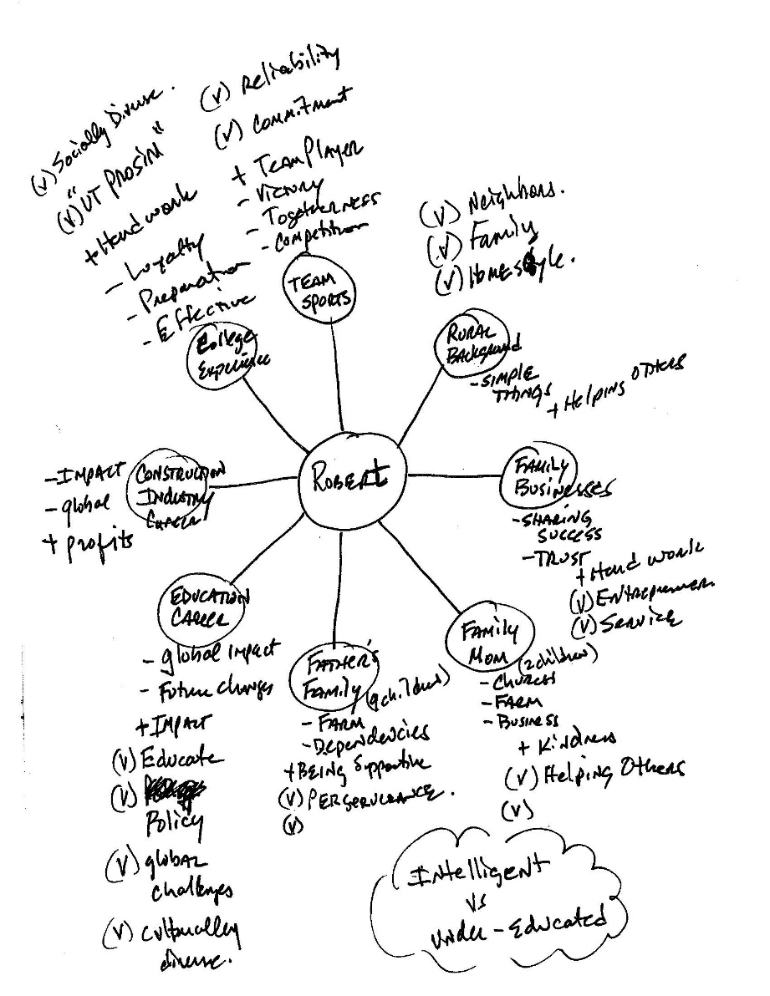
Training culturally diverse you
Example

